Slide 1


Aristotle University Sports Centre in partnership with
Department of Physical Education and Exercise Science of
Aristotle University of Thessaloniki.

Slide 2
What we have done:
Hosted meeting with DPESS and the staff of the 2 participating schools from Greece (module presentations by DPESS)
Attended the meeting
Led the development of the training module 6
We prepared 2’ video about the Aristotle University Sports Center (the video is in the program web site).
Developed a pilot program of Scholl visits in Aristotle University Sports Centre that would later feed to modules 5 and 6.
Preparing a staff conference for the PHWB (April 2016)
Notes:
We make our study about the module 6 and we work on it in collaboration with Vasilis for its contents according the proposal from ….....
We hosted in our gym the first meeting with DPESS and the staff of the 2 participating schools from Greece. That meeting was the first meeting for all participant from Greece and we discused the institutions presentations for the web site and how to develop the module 5 and 6.

Slide 3
Activities of Auth SC that focus on Pupils Health and Well- Being (module 5 & 6):
Notes:
Well this is the that we have done till now for the project. To say the truth we did do a lot of thinks because we have already programs or activities that direct related with the aims of the PHWB – project. And these activities I will present to you for the next few minutes.

Slide 4
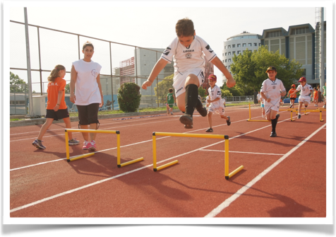
Auth Sports Academies for Children aged from 6 to 12 years old (October 2015-June 2016)
Track & Field
Soccer
Basketball
Volleyball
Karate
Tennis
Gymnastics
PE Program for preschoolers (3-5years old)
Notes:
Our first big program is the Auth Sports Academies for children aged from 6 to 12 years old. This program is a year around from October to June and have 8 different sports activities. These activities are …...... The Auth Sports Academies operates only the weekends (Saturday Sanday) from 9 to to 2 o clook. The Aim of this program is actually to change pupils and parents behavior for the physical activity and sports. We try to make children to love sports and to do the sport that they like for life time for fun and for their self. We work very close with parents and we try to convince them during the program to do exercise for their self at our fitness center (free of charge) or to play with their children after the training session. We are very proud of this program because all these years has been accepted with great success both from the academic community and the local community. This is the pupils participation over the years. As you can see we started back to 2007 with less than 100 puplis and in now days we over a thousand.
Finally in this pie you can see the pupils participation in aur activities. Soccer and track and Field are the most popular.

Slide 5
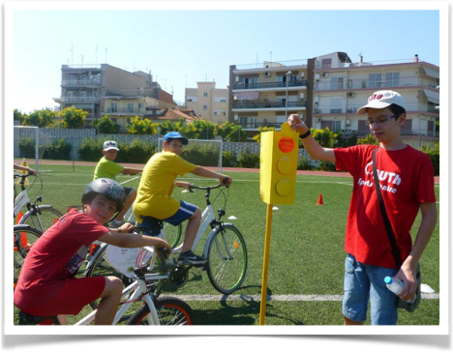
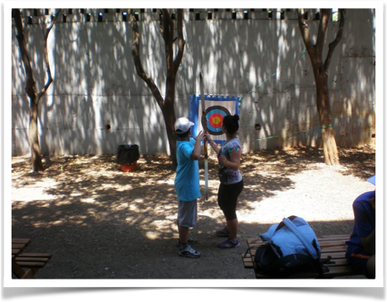
Auth Summer Day Camp for Children aged from 6 to 12 years old (June-July 2016)
Notes:
The second program is our summer day camp activities for the same aged group. This program is every weak day program from 8pm to 4am. And in our activities we have in total 500puplis a 125 pupils per weak.
As you all understand we can use all the modules of this project (especially 5 & 6) that we design to this day camp program.

Slide 6
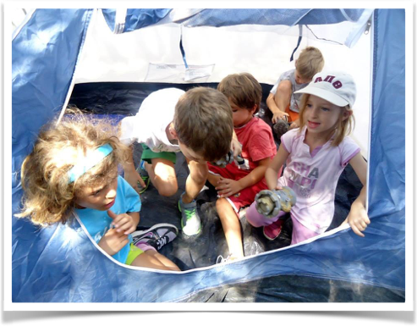
Auth Day Life Skills Camp for Children aged from 6 to 12 years old (September 2016)
Goal setting
Socialization
Music
Diet
Cooking
Swimming
Natural magic
Camping, living in nature
Notes:
The third program is the closest to the objectives of the project. We call it auth day life skills camp for children aged from 6 to 12 years old. This program is every day program for two weeks. We have a 100 puplis per weak and the aim of the program is to teach pupils life skills through their participation in sports activities. In this chart you can see parents evaluation of the program Here in the last one is the total satisfaction which is almost excellent.

Slide 7

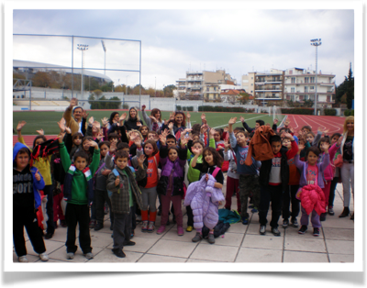
Educational school Tours (visits) to the Auth S.C. (September 2015 – June 2016)
Notes:
And at the end I will present our last program which is educational school visits in our gym facilities. During these visits, students have the opportunity to become familiar with all the facilities of the gym and take part in a specially designed program by staff of the gym.
In thiis chart you can see the evaluations of the threshers from the school that participated in the program. As you can se the program has gotten excellent reviews in almost all sectors of the evaluation.
And here is the puplis participation 3000 for our first year 6000 for the second and 3000 for the first semester of this year .
And this program is very promising because a large number of students participating in it and there is the possibility to influence them for a better lifestyle through the promotion of physical activity and sports. With other words in this program we can fit very easy the the modules of our project.

Slide 8
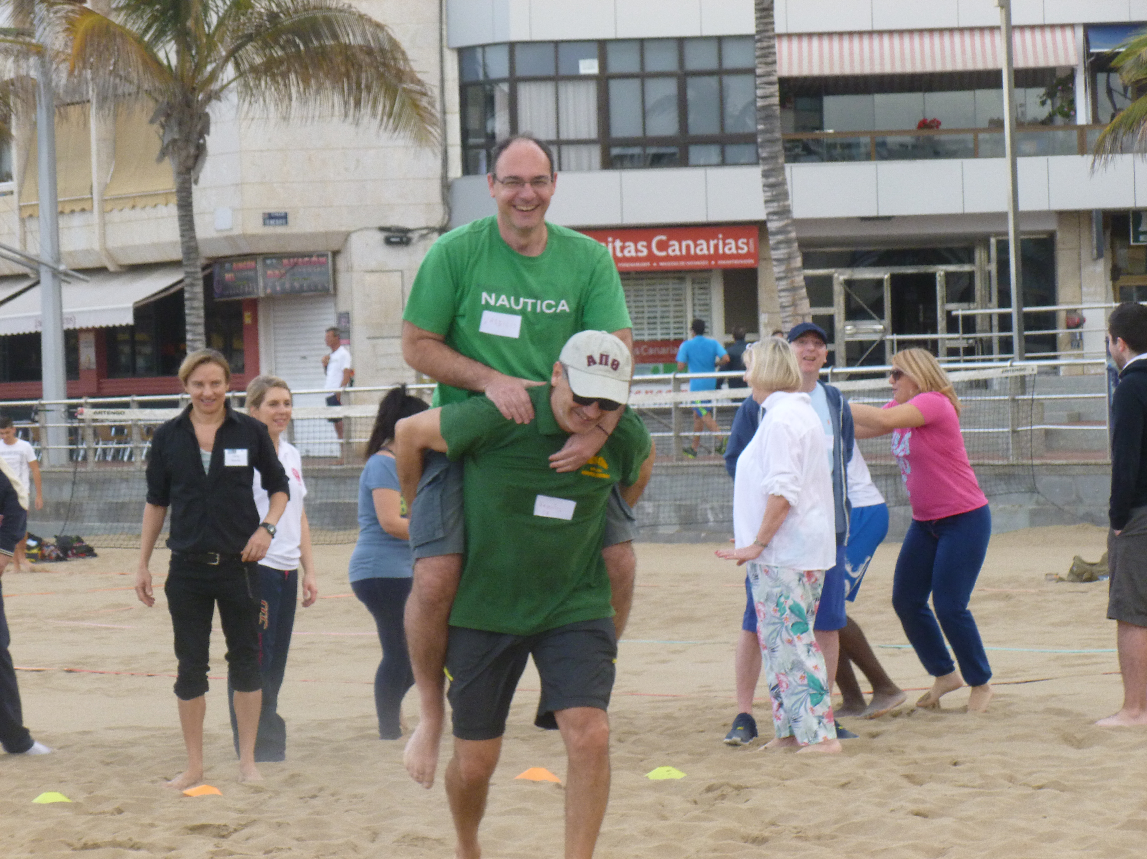

Slide 9
