Slide 1




Pupil Health & Well-Being — an Education Priority 4 Europe’s Schools
Dissemination plan

Slide 2
Dissemination plan:
1. the Logo
2. the website
3. project fact sheet
4. press release
5. youtube channel
6. social media
7. PE associations
Collaborative input:
Conference/workshop attendance.
Training events.
Project publicity/ journals
Other activities.

Slide 3
To ensure wide reaching impact.
1. stakeholders ( invite to training)=
Shared= revised= re- used
Open access
Establish social media presence;
Posters at relevant conferences presenting project objectives
Test communication channels

Slide 4
All materials, teacher lesson plans, on line resources, Power Point presentations, case studies, video tutorials, guidance materials and advice for local decision-makers (e.g. Deans, Learning & Teaching leaders, Heads and School Governors, LA advisers) that comprise each module will be published on our project web site and freely available for any schools/ school staff wishing to utilize them to develop a whole school, inclusive approach to Pupil Health and well-being.

Slide 5
We produce INTELLECTUAL OUTCOMES.
We publicize them at MULTIPLIER EVENTS.
We run a TRAINING ACTIVITY in June 2017 to refine a training course for others and train our own partners’ teams to live the ‘whole school/ whole pupil’ approach to Health and Well Being for All.

Slide 6
TARGET GROUPS
Current/ future teachers
Needs analysis
Research project managers
Teacher Training faculties
UPDATES ON A REGULAR BASIS:
Identifying and informing about dissemination opportunities
Networking

Slide 7
Each University partner will publish 2 Journal Articles by the end of the second year of the project. (e.g. bi-annual TEAN -- Teacher Education Advancement Network Journal and Conference, Conferences of the European (FEPSAC) and International (ISSP) Assoc of Sport Psychology, Northern Greece Association of PE teachers, European Physical Education Review, Journal of health/Journal of School Psychology.)

Slide 8
60 Trainee Teachers from each of the ES and UK University partners each year and 200 each year from the GR University partner involved in the trialling of the University teacher training module outcomes developed by this project.
60 invited teachers from schools not in our partnership at local dissemination/ multiplier events (20 in each region).
60 trainee teachers mobile to our partner regions -- supported by Erasmus (University mobility) funding or other grants additional to this project if applications are successful (20 from each University).
2000 pupils that trainee teachers involved in this project come in touch with in schools during their school placements (100 each connected to each Trainee Teacher)
Local Greek teachers will be involved in a Multiplier Event delivered by all 3 countries as part of our 3rd Transnational Meeting in Thessaloníki and will provide feedback on the developing training module outcomes we will present to them. We expect 35 teachers not attached to the project to attend.
24 school teachers at training event where we roll out the training for teachers in Spain in 2017 --16 from UK and GR to get funding from this grant to participate, 8 from Spain partner schools not funded as they will be local... and in addition, we hope to have some additional teacher participants self-funded.
6 Local government advisers already connected to our institutions (minimum)--who will be invited to take part in transnational meetings held local to them --e.g. Head of Educational Standards, Jim Eshelby, Southwark LA in the UK, Diego Sanchez, Canarias Education Dept Advisory Team in Spain, Macedonia Education Board in Greece.
As well as producing 2 Academic Papers for publication in each partner country, we expect partners to lecture at Journal Conferences promoting these papers, at which as many as 100 educators per Journal Conference may be present.

Slide 9
Dissemination:
Logo
Website
Fact sheet
Fliers
Project presentation
Training events
Open ULPGC

Slide 10
Dissemination:
1. list of stakeholders per each country
2. list of journals/ conferences 2016- 2018
3. school networks
4. local/ national authorities
5. mailing list

Slide 11
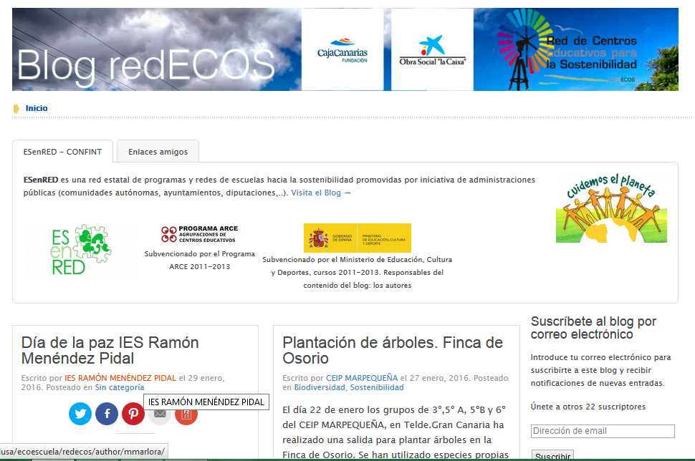

Slide 12
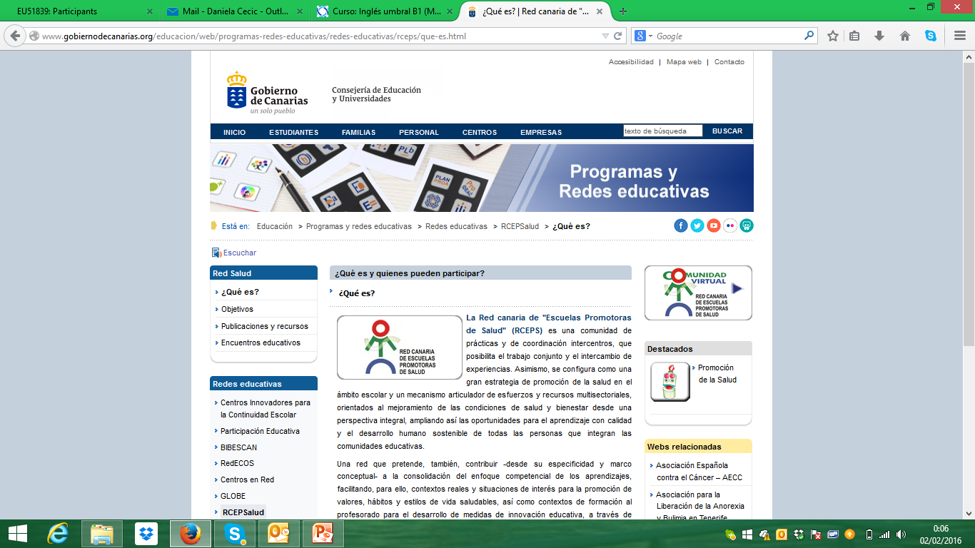

Slide 13

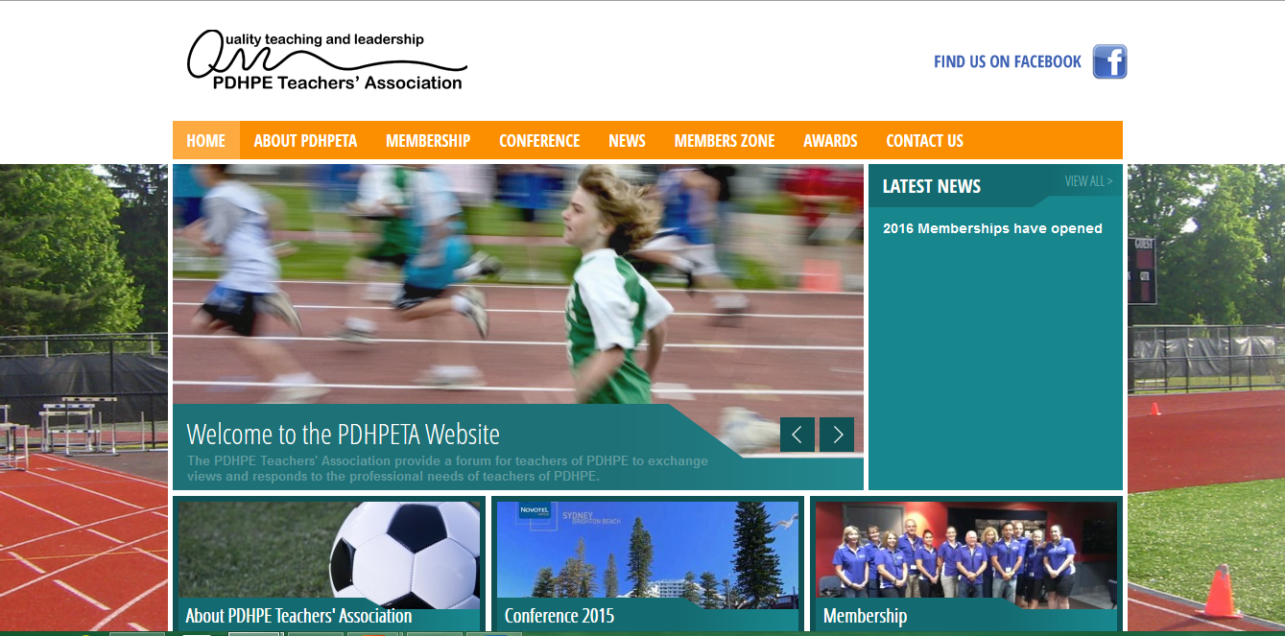

Slide 14
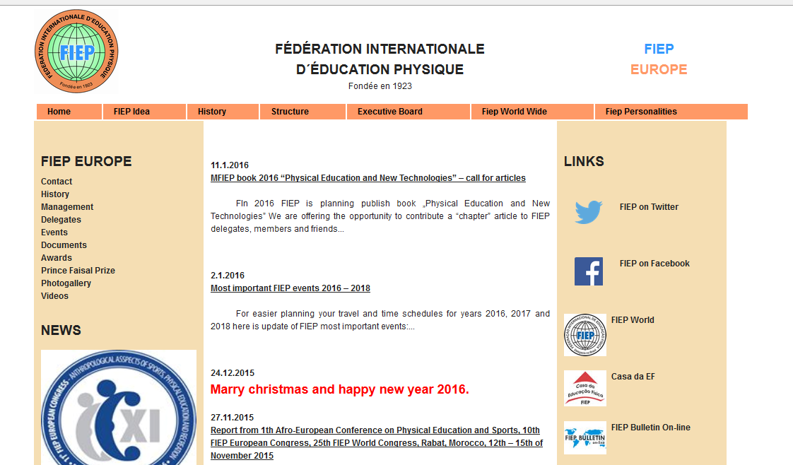


Slide 15
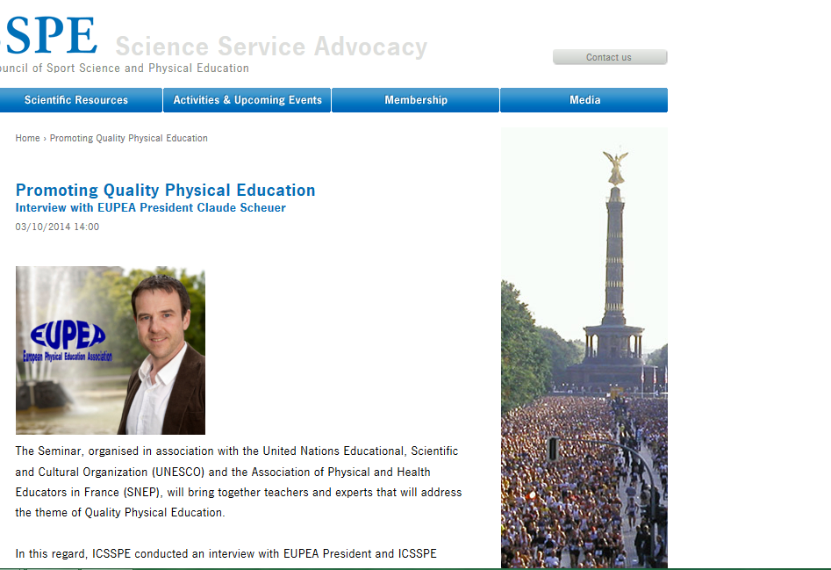

Slide 16


