Slide 1
Pupil health and wellbeing project – update!
John Donne School

Slide 2
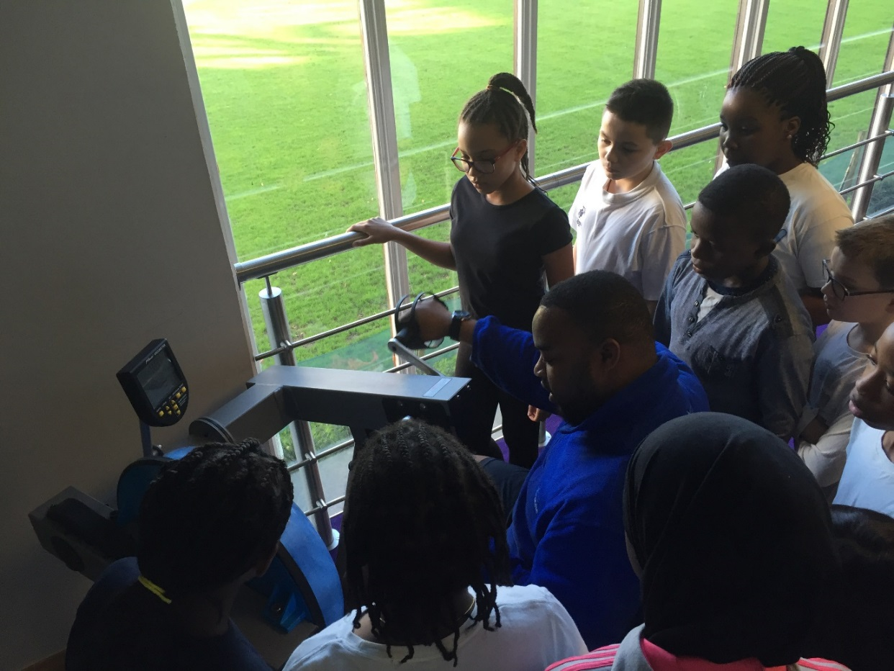
Years 5 and 6 now attend the gym

Slide 3
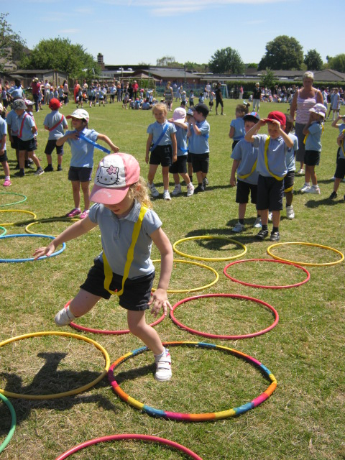
Pulse Gym to support our sports day

Slide 4
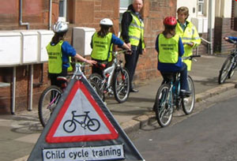
Ordered 10 bikes for the school to use with children of the school to help them with learning to ride and use a bike safely.

Slide 5
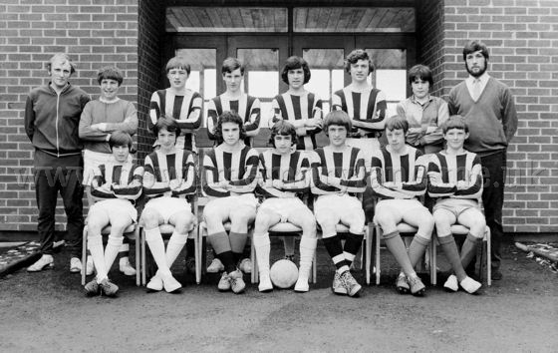
We have encouraged staff to take part in a mixed football team and have played a few games against local schools.

Slide 6

On Thursday 16th June 2pm, we hosted all school children in our sports hall to watch the European Championship game between England and Wales. This offers the opportunity for children and staff to get behind our nation whilst immersing ourselves in a European competition.

Slide 7
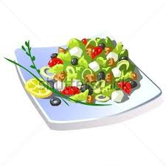
We have continued to offer a wide range of healthy meals for both children and staff and change this three-week menu every term.

Slide 8
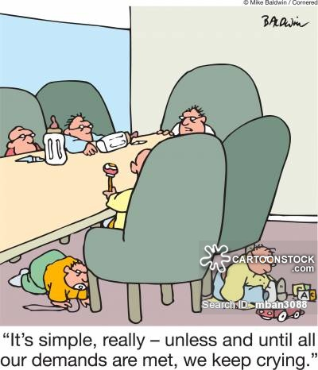
During school council meetings, pupils have been discussing development of the playground and the different opportunities for children.

Slide 9
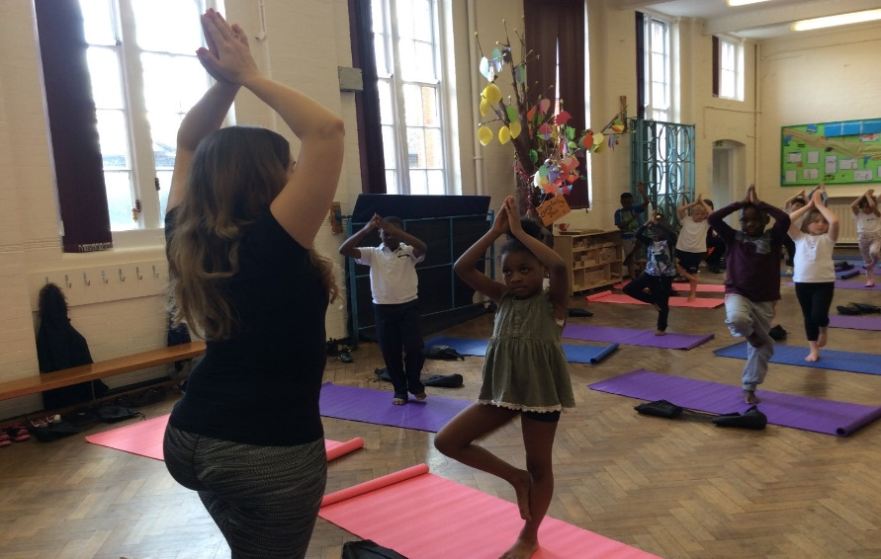
We have ordered and been using 36 yoga mats for lessons with Year 2 and Year 5 children. The children have been loving this as have the teachers.

Slide 10
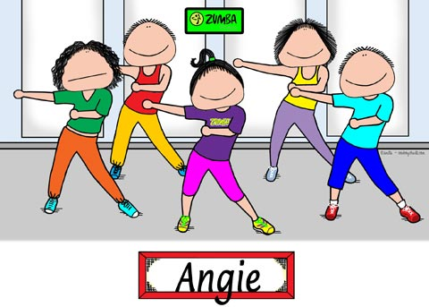
We hold Free Zumba sessions for parents on a Monday morning…….

Slide 11
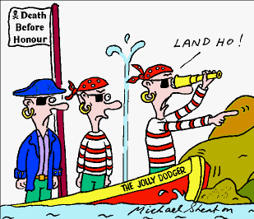
We are planning a team- building Inset with another local school in June (London Treasure Hunt)

Slide 12
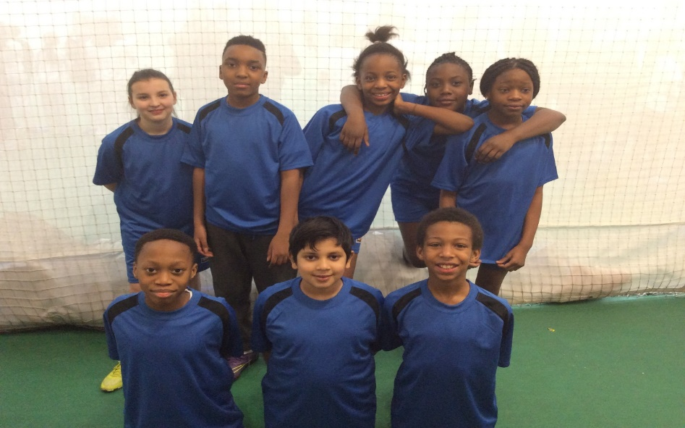
Taken part in a variety of sporting events both competitive and non-competitive. Here are our cricket team having won a tournament at the Oval Cricket Ground.

Slide 13
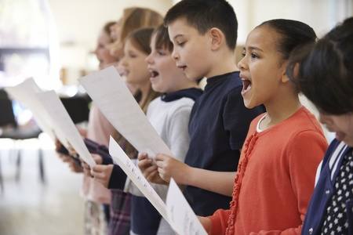
Lots of concerts and recordings for the choir and whole school…..

Slide 14
Weekly learning and fun sessions for parents and children after school
Intensive support for several families in serious financial difficulties
Food bank support for families in need of food
Free Holiday Club provision for pupils who are having difficulties at home

Slide 15
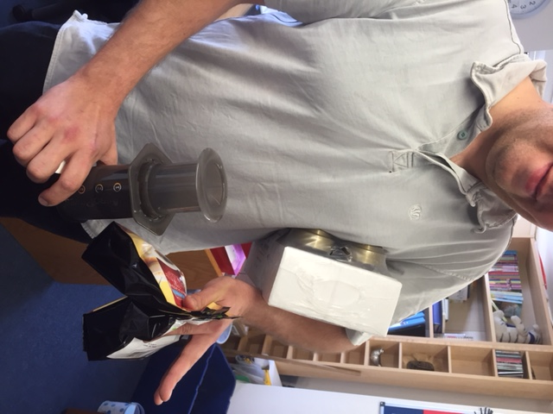
And finally…….fresh coffee available for all staff across the school

Slide 16
Impact:
Very low staff turn-over
Strong parental support when it`s needed
Strong sense of belonging for the pupils, parents and staff
Happy atmosphere that is frequently noticed by visitors
Good academic outcomes for pupils

