Slide 1
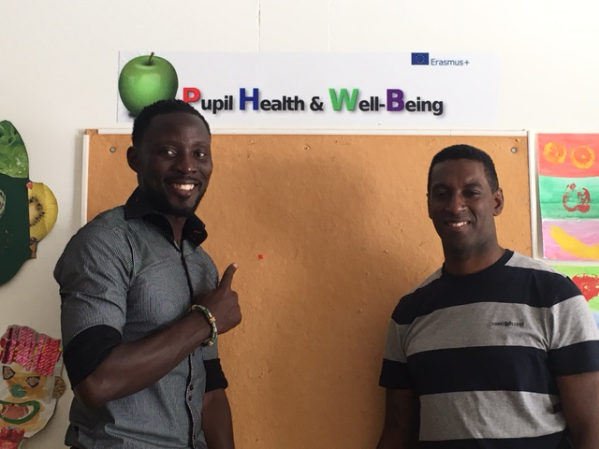
CLUB PULSE Job Shadow Visit in Greece
Notes:
This template can be used as a starter file for presenting training materials in a group setting.
Sections
Sections can help to organize your slides or facilitate collaboration between multiple authors. On the Home tab under Slides, click Section, and then click Add Section.
Notes
Use the Notes pane for delivery notes or to provide additional details for the audience. You can see these notes in Presenter View during your presentation.
Keep in mind the font size (important for accessibility, visibility, videotaping, and online production)
Coordinated colors
Pay particular attention to the graphs, charts, and text boxes.
Consider that attendees will print in black and white or grayscale. Run a test print to make sure your colors work when printed in pure black and white and grayscale.
Graphics, tables, and graphs
Keep it simple: If possible, use consistent, non-distracting styles and colors.
Label all graphs and tables.

Slide 2
Club Pulse PHWB Fitness program:
 | 6 Week Lesson Plan
 | Coach names:
 | Dean Suleyman / David Morrison
 | WEEK 1 | WEEK 2 | WEEK 3 | WEEK 4 | WEEK 5 | WEEK 6
 | :Mobility drills | Introduction to Mobility drills | :Mobility drills/ Revision | :Mobility drills/ Revision | Mobility drills/ Revision | :Yoga / tai chi
 | Gym induction | Introduction to key movement patterns | key movement patterns (weights) | :key movement patterns (weights) | :key movement patterns (weights) | :Gym workout
 | Major Muscle names | Squat, Shoulder Press | Squat, Deadlift, Shoulder Press | Squat, Deadlift, Shoulder Press | Squat, Deadlift, Shoulder Press | Cardio and Strength training
 | Muscle Movements | (bodyweight) | Circuits | Introduction to Free weights | Free weights Training
 | Health & Safety in Gym | :Circuits | Core strength Development | Core Strength Development | Core Strength Development
 |  | Intro to Core strength (beginner)
 |  | :Cool down | Cool down | Cool down | Cool down
 | SESSION OUTCOME | SESSION OUTCOME | SESSION OUTCOME | SESSION OUTCOME | SESSION OUTCOME | SESSION OUTCOME
 | knowledge of gym etiquettes | Understanding of Warm up | Ability to demonstrate the Squat & Shoulder Press Proficiently | Ability to perform squat, deadlift shoulder press with weights | Ability to perform squat, deadlift shoulder press with weights | Gym workout experience
 | Knowledge of Muscles | Basic knowledge of key movements | Knowledge of deadlift and other core exercises | Core strength Development | Dev Core Strength and knowledge of core exercises | Experience of Yoga/ Tai Chi
 | Knowledge of Exercise Machines & their function | Knowledge of the Squat & Shoulder Press | Full Body Workout 15mins | Knowledge of body parts muscle movement | Knowledge of body parts muscle movement
 | Health & Safety in Gym | Full Body Workout 15mins

Slide 3
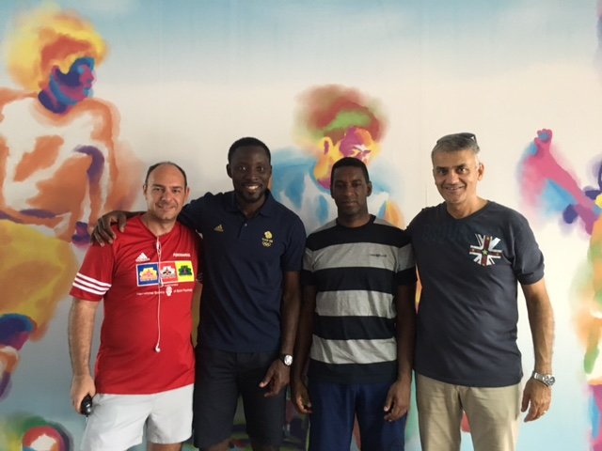
Objectives of Visit:
Exchange ideas
Improve PHWB programme at Club Pulse

Slide 4
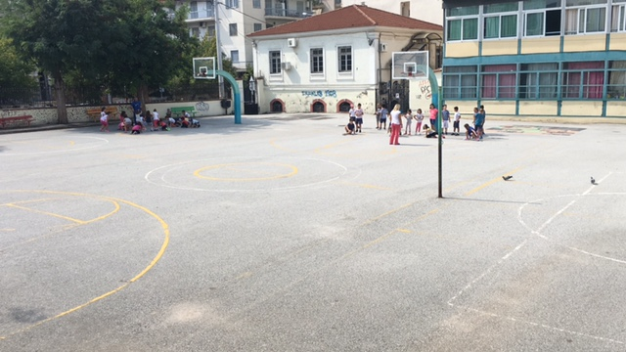
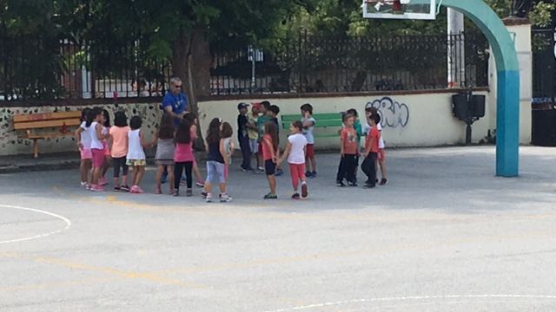
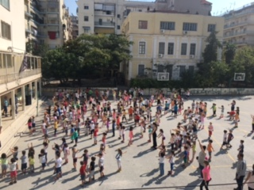
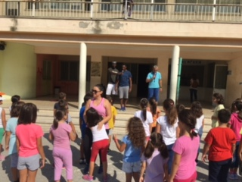
What did we do
Visit experimental primary school

Slide 5
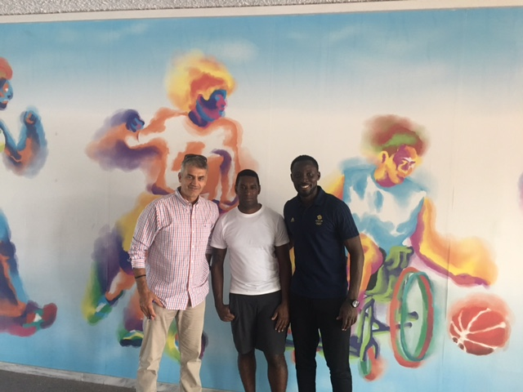
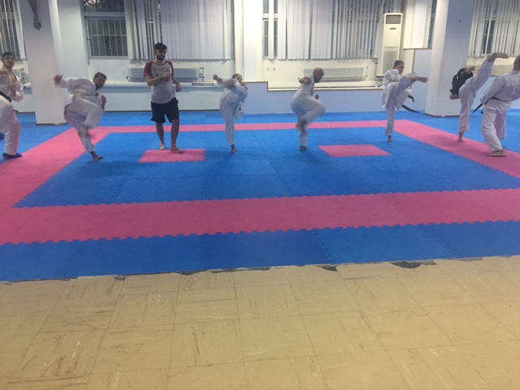
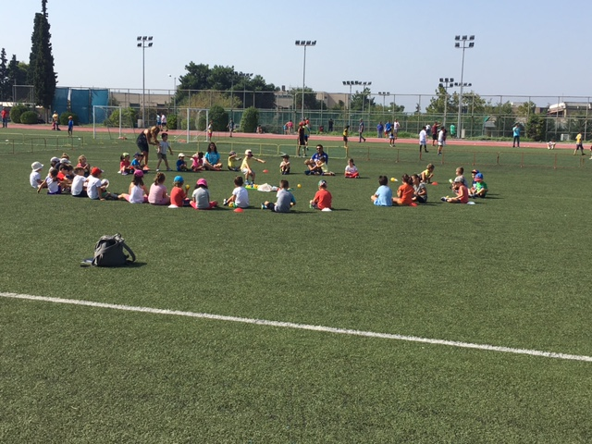
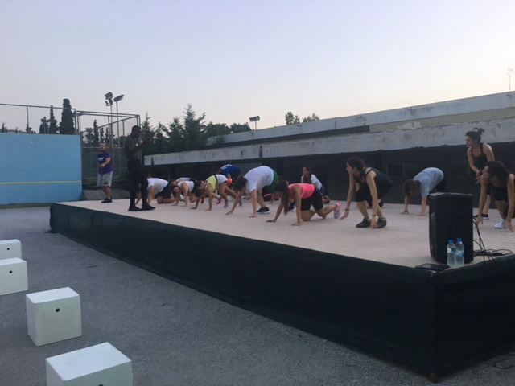
What did we do
Visit Aristotle University Sports Centre

Slide 6
Observations:
Community Approach
Family and Parents Presence
Emphasis on Sport And Games Participation

Slide 7
Club Pulse After Greece
Parents & Children fitness Sessions
Promoting Games on the Club Pulse Green
Encourage Sports Day Programs on Green

Slide 8
Interactive games for Parents and Pupils
Interactive wall lights
Interactive Fitness brought to you by Pulse Fitness

Slide 9
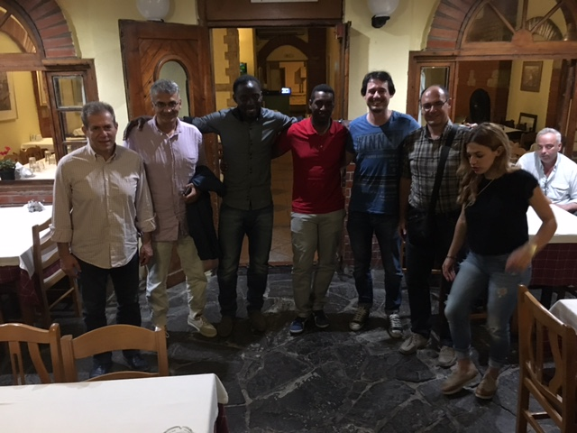
Fun and learning Experience
THANK YOU GREECE

