Slide 1

USING LOCAL ENVIRONMENTS AND COMMUNITY INVOLVEMENT TO PROMOTE HEALTH
MODULE 5
Notes:
Welcome participants. Brief introduction to Module 5 (2’)

Slide 2

Session 1: Community participation in health promotion

Slide 3
Objectives of the session
To become aware of health as a social issue.
To learn about necessary strategies to promote community participation in health.

Slide 4
Health as a social issue
medical
Health:
issue
social
Direct influence of social factors on health
Strategy for an effective development
Community participation
Notes:
Public health authorities are developing global strategies to combat social triggers.

Slide 5
Sedentary lifestyles
overweight
Sedentary
lifestyles
rise in
chronic diseases
Human pandemic
Obesity
60 million children with obesity problems
By 2020
Notes:
Activity: start the lesson by discussing the consequences of sedentary lifestyles on health (5’).
In 2014, 1.9 billion adults were overweight.
Overweight and obesity also involve an important economic cost since, according to a WHO report (2014), it generates a 1.8 billion euro expenditure for the world economy, which is approximately 8% of the Gross World Product (GWP).

Slide 6
Smoking
Main cause of illness and death around the world: 5 million people
Young people in Europe are starting to smoke at an earlier age.
Its development is linked with social and cultural factors.
Notes:
By 2030, the number of deaths from tobacco in the world will reach 10 million.
Smoking increases the probability of suffering severe diseases such as:
Lung, laryngeal, esophageal… cancer
Angina and heart attack
Respiratory diseases: chronic bronchitis
Metabolic disorders: diabetes
Activity: discuss in groups what are the social and cultural factors that influence young people into starting to smoke at an earlier age (10’).
The main social and cultural factors are:
Environmental factors (direct and indirect advertising by sponsoring sport, cultural, social and even charity activities; accessibility to cigarrettes through automatic vending machines)
Social factors (family: parents’ and older siblings’ attitude towards tobacco; group of friends, especially during adolescence)
Personal factors (not doing any sports, school failure, family conflicts, etc.).

Slide 7
Alcoholism
Third place among the risk factors for poor health worldwide
Alcoholism
Our current society is too permissive about it
Alcohol consumption
Many health and social problems
Notes:
Alcohol causes 3.3 million deaths every year, many of them of young people.

Slide 8
Stress
Risk factor in cardiovascular diseases
Stress
Personality and lifestyles can lead to a situation of chronic stress.
Causes highly negative changes in health.

Slide 9
Education for health and evolution of this concept towards a participatory approach: Traditional model and participative model
Education for Health (EfH): tool to promote health.
useful to give information
EfH
to motivate citizens in the promotion of their health
EfH models
Traditional
Participative

Slide 10
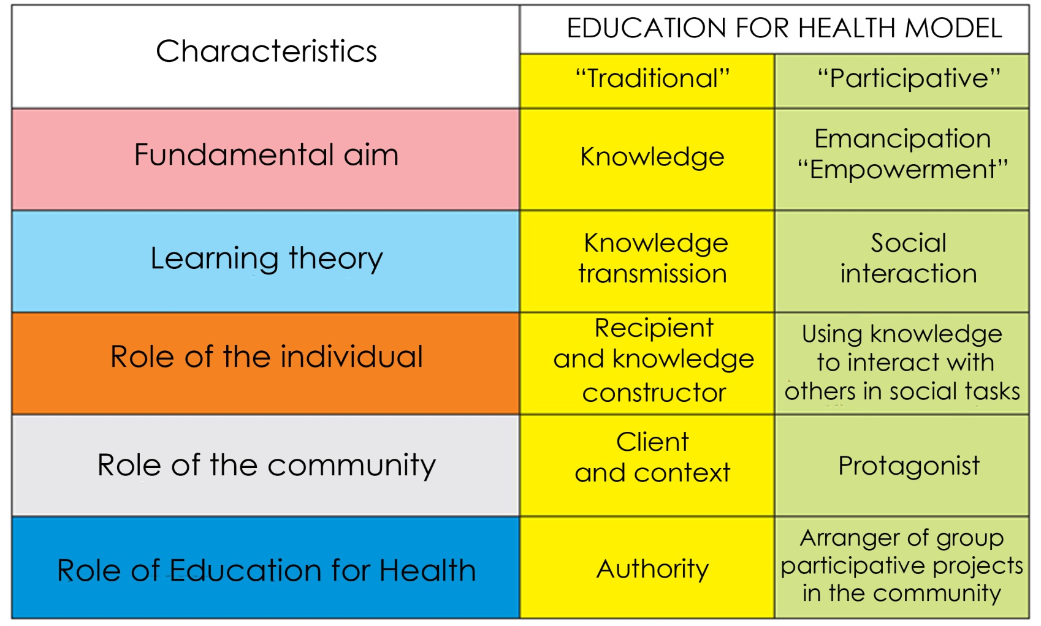
Education for health and evolution of this concept towards a participatory approach: Traditional model and participative model

Slide 11
Community participation: strategies to promote processes of change in local contexts
Citizens must participate in health promotion
The Ottawa Charter (1986)
favour integration
Health promotion programmes
cross-sectoral
shared responsibility between the State and the population
Advantages
citizen empowerment
improved efficacy
greater social cohesion

Slide 12
Strategies to promote social participation
Creating spaces for negotiation to promote co-responsibility in the National Health System.
Institutionalising citizen and worker participation in the adminstration of the Health System.
Expanding the knowledge, capacities and abilities of the population regarding health.
Creating mechanisms that allow social participation in the administration of the System.

Slide 13
Model for community participation in Health: precede-proceed
PRECEDE-PROCEED MODEL
Method of community participation to promote health.
It explains health-related behaviours
To plan and evaluate interventions
ADVANTAGES
To influence behaviours and life conditions

Slide 14
Model for community participation in Health: precede-proceed
PRECEPTS OF THE PRECEDE-PROCEED MODEL
It improves the quality of life
Participative process
Health as a community issue
Notes:
Health is included within the context of the quality of life.
Health goes beyond physical well-being or the absence of disease.

Slide 15
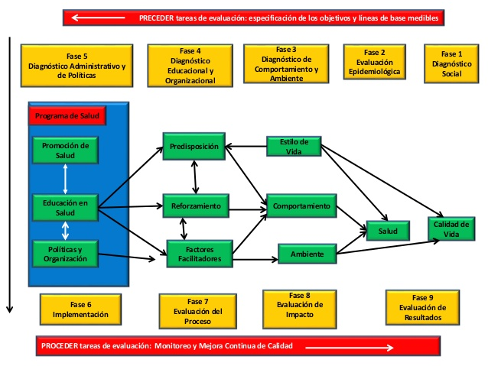
Model for community participation in Health: precede-proceed
Notes:
Activity in small groups: the group is divided into four subgroups to put into practice the Precede-Proceed Model in the context of a specific school. Only the first four phases will be developed, each by one of the subgroups. At the end, every subgroup presents their work to the rest of the class.
Phase 1. Social diagnosis.
Assess the level of quality of life of the community members through their perceptions in relation to their strengths and resources in the social, economic, cultural and environmental spheres. Their needs and difficulties are also analysed.
This stage starts with the compilation of sociodemographic data, which are presented to the community to help citizens decide the priorities. This is about how to determine what the citizens want for their community.
Phase 2. Epidemiological diagnosis.
In this phase, the health behaviour, lifestyle and/or environmental factors that influence health most clearly are identified.
Phase 3. Behavioural and environmental diagnosis.
In this phase, the factors contributing to predisposition, facilitation and reinforcement are identified.
Predisposing factors. They are the basic intelectual and physical conditions that tend to make individuals have more or fewer possibilities of adopting healthy or risky behaviours.
Enabling factors. Those internal and external conditions that help people adopt and maintain healthy or detrimental behaviours and lifestyles.
Reinforcing factors. People and community attitudes that support or create difficulties for the adoption of healthy behaviours or the promotion of healthy environmental conditions.
Phase 4. Educational and organisational diagnosis.
The administrative and normative factors that influence the intervention about to be implemented are identified. The structure, the procedures and the culture of the organisation are taken into account, as well as the availability of necessary resources for the intervention.

Slide 16
Session 2: Health promotion in urban areas (1st part)
Pupil Health & Well-Being

Slide 17
Objectives
  To educate for a healthy diet
  To promote environmental education in order to develop healthy living habits and foster pupil well-being.
Notes:
Close relationship between the physical environment, lifestyle habits, social and economic conditions and health.
Need to address what type of food is consumed in the urban environment.
Environmental conditions affect the living conditions of pupils and their well-being.

Slide 18
  Educating for a healthy diet
Social and economic conditions
access to fresh foods
The selection of the foods that make up the diet
depends on nutrition knowledge
nutrition education
transforming everyday life habits
horticultural production

Slide 19
Strategies to promote a healty diet from school

Slide 20
1. Creating eco-friendly school gardens
1
To respect the environment.
3
To understand the connections between diet and health.
2
To learn how to grow healthy foods.
5
4
To detect links between horticulture and proper nutrition.
To appreciate the value of fruits, vegetables and legumes.
6
To reject junk food.
Learning objectives
Notes:
Activity: In small groups, try to answer the following question previously: what specific objectives can be achieved with the creation of an eco-friendly school garden? (10’)

Slide 21
1. Creating eco-friendly school gardens
2. Nutrition Education
3. Healthy diet
1. School Garden

Slide 22
2. Educating for a healthy diet
nutrition education
dietary habits
Combining
horticulture
Change in the daily food consumption
Interest in vegetables
Notes:
Food production at school is only useful if it is supported by nutrition education.
Activity:
Watching videos about the creation of school gardens and analysing each of them (15’)
http://blog.oxfamintermon.org/como-hacer-un-huerto-en-casa-con-poco-espacio/
How to build a school garden
https://www.youtube.com/watch?v=qXO5NYV6bCc
https://www.youtube.com/watch?v=ozlL2AvkR04
https://www.youtube.com/watch?v=AYnmUKaVeuM

Slide 23
3. Steps to implement school gardens
1. Thinking about:
what do we eat?
what can we grow?
2. Analysing the situation
what is needed?
3. Deciding what is going to be grown
why?
4. Planning the steps
what procedures?
5. If the products are consumed at school
planning the meals

Slide 24
4. Advantages of using school gardens
Advantages
Highly motivating activities
Cooperative teaching
Interaction with the family and the community
Learning
by doing
Meaningful learning
Increasing their knowledge
Notes:
Activity:
Learning about other educational experiences through the web and the videos available (15´).
Mare de Deu del Carme School: the garden is part of the educational activities of the institution, but with the cooperation from the neighbours in a plot owned by the Tarrasa town hall (Spain).
http://ecokarmel.blogspot.com.es/search/label/Hort%20urb%C3%A0
Edible School Yard in Berkeley, California: they grow organic foods, prepare them and consume them at school.
http://edibleschoolyard.org/

Slide 25
5. Supplemental educational activities I
1
Building a tank to collect rainwater
2
Making information leaflets about the nutritional, social and economic value of some of the products
Keeping the accounts for the products
4
Analysing the products used for lunch at school
3

Slide 26
5. Supplemental educational activities II
5
Developing training activities with families about:
Getting families involved with the creation of home gardens
6
nutrition education
the self-production of food
balcony or terrace
rooftops
house gardens

Slide 27
Educating for environmental care

Slide 28
1. Educating for environmental care I
Health depends on the quality of
natural environment
social environment
built environment

Slide 29
1. Educating for environmental care II
Factors
water quality
air quality
lighting
noise
smells
Environmental factors affecting health

Slide 30
2. Air pollution
Traffic and means of transport Heating systems
Industrial emissions
Agriculture and livestock farming
Causes
Consequences
excessive mortality rates
high economic cost
diseases in the population
  .
Notes:
Preliminary activity:
What are the causes and consequences of air pollution? (10’)
The most common diseases in the population due to air pollution are: bronchitis, lung cancer, cardiovascular diseases and asthma in children

Slide 31
3. School strategies against air pollution
improves air quality
Limiting the access of vehicles around the school
reduces noise levels
increases safety
Lower levels of air pollution
  Planting trees and vegetation at school
Improves pupils’ physical health
Improves mental health
Notes:
According to the Centre for Research in Environmental Epidemiology (2015): the higher the number of trees within and surrounding the school boundaries:
the lower the level of air pollution inside and around the school
this improves pupils’ physical and mental health.
Thus, planting trees at school and vegetation around it is necessary.

Slide 32
4. Noise pollution
Causes
Industrial activities
Construction activities
Means of transport
Leisure activities
Notes:
Preliminary activity:
What are the elements or factors that generate noise pollution? (5’)
Many leisure activities produce an increase in the exposure to loud sounds at entertainment venues such as cinemas, nightclubs, concerts, sporting events and gyms.
Many young people and children usually listen to music through music players and mobile phones with high volumes for a long period of time.
Nearly 50% of the teenagers and young people aged from 12 to 35 are exposed to noise levels that are very detrimental for their health.

Slide 33
5. School strategies against noise pollution I
the exposure to high noise levels
Raising pupil awareness of:
the good uses of mobile devices
A noise map of the area
Action plans to reduce noise at school
Notes:
It is important to learn about the health guidelines concerning noise levels as adviced by the World Health Organization.
Pupils need to become aware of the importance of keeping the volume of the device low, lower than 60% of the maximum volume. The use of earplugs to protect the inner ears at sporting events or other noisy environments must be promoted as well.
Activity:
Working in groups, each of them will create a noise map of a certain school, as well as a plan to reduce environmental noise at that school (30’).

Slide 34
5. School strategies against noise pollution II
Analysing noise levels at school
Creating a campaign to raise awareness
All against noise!
Notes:
To analyse noise levels at school, pupils will measure them by using mobile devices, downloading the app “Sonómetro”; it will detect the daily average amount of noise in different areas of the school and at different times of the day.

Slide 35
Session 3: Health promotion in urban areas (2nd part)
Pupil Health & Well-Being

Slide 36
Objectives
  To promote pupil mobility and physical activity from school
  To make pupils aware of the healthy use of public open spaces

Slide 37
Theoretical justification
Mobility and physical activity
the health of the individuals and the community
affect
Physical inactivity
risk factor for mortality
Regular physical activity
reduces
the risk of diseases
Notes:
Preliminary activity:
Analyse in groups the consequences of physical inactivity on health (5’).
Mobility and physical activity affect the health of the individuals and the community.
Physical inactivity is the fourth leading risk factor for mortality (3.2 million deaths every year).
Regular physical activity reduces the risk of diseases: coronary heart diseases, cerebrovascular accidents, type 2 diabetes, depression, hypertension, colon and breast cancer.
It is essential for weight control.

Slide 38
Benefits of physical activity for the health of children and young people
it reduces body fat
greater bone health
psychological
it improves fitness
Benefits
Recommendation
60 minutes per day
At least 3 days a week
Doing endurance and aerobic exercises
Two 30-minute sessions
Notes:
Preliminary activity:
What are the benefits of physical activity for the health of children and young people? (3’).
The benefits of physical activity for the health of children and young people between 5 and 17 years old are:
it improves fitness (both muscular strength and cardiorespiratory functions),
it reduces body fat,
greater bone health
psychological: less symptoms of depression
Moreover, it is recommended to practise endurance exercises at least three days a week to improve muscular strength, as well as aerobic exercises to improve cardiorespiratory functions.

Slide 39
How to develop physical activity in children?
Physical activity
games
journeys
sports
recreational activities
Physical Education
programmed exercise in the family
community activities
Notes:
Activity:
In small groups, think about what type of exercises can be done to develop physical activity in pupils; each group will make a list of possible activities in different areas, that is, one will deal with recreational activities, another with community activities and the third one with exercises in the family (10’).

Slide 40
Mobility I
  the social and economic context
Physical activity is constrained by
natural
the physical environment
urban
individual preferences
Using private vehicles
Active mobility
doing physical activity
physical inactivity
sedentary lifestyles

Slide 41
Mobility II
Keeping physically active
Mobility: travelling to school
At home
During leisure time
Notes:
Keeping physically active within three areas is important:
- during studies, promoting mobility: by walking or cycling to school;
- at home: with household chores or gardening;
- during leisure time: joining sporting activities.

Slide 42
Mobility and activity encouragement from school
1
2
it expands social contact
3
it reduces stress
it reduces air pollution
4
it increases physical activity on the way to the transport access point
Raising pupil and family awareness of the use of public transport
Notes:
Preliminary activity:
In groups, think about possible strategies to develop from school to encourage mobility and activity.
Public transport favours physical activity on the journey to the transport access point, on foot or by bike. The reasonable distance ranges from 300 to 500 metres.
A good system of public transport facilitates the access to public health, social and education services, which is especially important for vulnerable groups within the community (children, elderly people, disabled people, etc).

Slide 43
Other strategies for activity encouragement from school
1
Physical activity as a daily routine
Promoting mobility within short distances; e.g.: just about 500 metres (5-10 minutes on foot.)
3
Walking or cycling to get to extracurricular activities.
2
4
Using public open spaces that are suitable for active leisure time: safe and attractive
Notes:
Raising awareness to include physical activity as a daily routine. Thus the minimum required amount of daily physical activity is reached. There is success when the easiest choice for the person is a behaviour that is favourable to health.
Promoting the use of public open spaces that are suitable for active leisure time. The safer and the more attractive, the greater the activity.
Especially those public open spaces equipped with cycling and walking routes, sport pitches and facilities, baskets, etc.

Slide 44
Mobility and activity encouragement from school III
groups of children under adult supervision
groups of children walking to school on their own: community involvement
Designing safe access routes to school
cycling to school, with safe routes
enough parking space
Notes:
Designing safe access routes to school:
- groups of children under adult supervision can walk to and from school. Families can take turns in daily surveillance.
- groups of children walking to school on their own: community involvement from shops, neighbours, etc. is required to watch their route to and from school.
- cycling to school, designing safe routes together with local authorities. The education centre must get involved and provide enough parking space for bicycles.

Slide 45
Public open spaces I
parks
gardens
squares
pedestrian zones
rivers or beaches
Green areas
open to all citizens
contribute to social cohesion
Characteristics
promote physical and mental health
promote social relations
reduce stress and mental burnout
Notes:
Public open spaces include green areas such as: parks, gardens, squares, leisure areas, pedestrian and cycling zones, as well as rivers or beaches in those urban areas.
They are a place for meetings, demonstrations and creative events, which are usually spontaneous and uncontrolled, but offer opportunities for physical activity.
They are spaces open to all citizens without any gender, age or socio-economic discrimination.
These spaces contribute to social cohesion and promote physical and mental health, especially in children.
They favour communication and social relations, improving self-esteem and reducing the risks of social isolation and depression.
These green areas and gardens reduce stress and mental burnout through the contact with nature.

Slide 46
Public open spaces II
They can be used in a way that is
comfortable
autonomous
barrier-free
safe
Their use is promoted if:
street furniture
They are equipped with elements
shade
fountains
playgrounds

Slide 47
Other determining factors for pupil health, physical and mental well-being

Slide 48
Other determining factors for pupil health, physical and mental well-being
houses or flats
with damp or
low indoor
temperatures
Diseases:
asthma, allergies…
Having a home
chronic stress
overcrowding
respiratory infections
poor physical and mental health
unsafe social
environments
no interaction
or social cohesion
Notes:
Teachers must be aware of the living conditions of the school pupils, because they affect their personal well-being as well as their performance at school. Therefore, the decisions made at the education centre must not be detrimental to pupils living under these conditions, but provide an answer to their needs.
Many native and immigrant pupils live in houses or flats with damp. Because of it, they suffer from diseases such as asthma, allergies and respiratory infections.
Low indoor temperatures in these places are associated with a poor health condition and with possible cardiovascular diseases in children and young people.
Overcrowding is related to chronic stress and the transmission of respiratory infections.
If the houses are located in unsafe social environments, this has a negative effect on physical and mental health and does not favour either interaction or social cohesion.

Slide 49
Safety
lack of social contact
isolation
Insecurity
reduction in daily physical activity
good visibility
easy and safe journeys
Public
spaces
lighting
Shops and other services on the ground floors
more activity
in the streets
good natural
surveillance
Notes:
Insecurity provokes a lack of social contact, isolation and a reduction in daily physical activity.
Anti-social behaviours or poor neighbourhood conditions are associated with a greater sense of insecurity. Public spaces must provide good visibility to support easy and safe journeys. Besides, lighting in these places must be adequate. Moreover, shops and other services on the ground floors produce more outdoor activity, as well as a good natural surveillance system in the streets.

Slide 50
Session 4: Health promotion in natural areas
Pupil Health & Well-Being

Slide 51
Objectives
  To promote pupil use of green areas from school
  To learn about the positive effects of using green areas on pupil physical health.

Slide 52
Theoretical justification
Reducing risk factors for obesity
attitudes and behaviours
Intervention
Effectiveness of green areas
Stress
Attention Deficit Disorder
hyperactivity
anxiety
Nature Deficit Disorder in childhood
high costs are avoided
economic
social
health
Minimum investment
Notes:
Six out of ten Europeans is obese or overweight (59%).
Reducing these risk factors through direct intervention on individuals’ attitudes and behaviours is necessary. Green areas make a very effective contribution to achieve these aims.
Children are affected by a Nature Deficit Disorder; it consists of a group of diseases such as stress, Attention Deficit Disorder-hyperactivity and anxiety, that affect children due to a lack of contact with nature (Louv, 2005).
A minimum investment promoting the contact with nature allows to avoid high economic, social and health costs in the future (Giraldo, Toro, Macías, Valencia y Palacios, 2010).

Slide 53
Positive effects of using natural areas for health and welfare I
Reduction in cardiovascular diseases
Positive effects on health
Vitamin D production
Recovery from illness
Increase in the immune response system
Social involvement
Other benefits
Promotion of healthy lifestyles
Enjoying good experiences
Notes:
Preliminary activity:
In small groups, analyse what are the positive effects of using natural areas on pupil health and welfare.
There is a wide range of positive effects of using green areas on pupil physical health (Mujica, 2013). They are compiled in the slides.

Slide 54
Positive effects of using natural areas for health and welfare II
Reduction of violent attitudes
Facing life in a more positive way
Psychological well-being
Other benefits
Improving self-esteem
Greater productivity and concentration
Group cooperation attitudes

Slide 55
Advantages of using natural areas I
Children with access
to nature:
1
Learn better
2
3
4
Are usually quieter and well-behaved
Are more creative
Tackle their physical and emotional deficits

Slide 56
Advantages of using natural areas II
Greater
motivation
exceptional educational situations for the child
It
improves
physical attitude and motor skills
Other advantages
Experiences for personal growth
It favours
An emotional and powerful bond with nature

Slide 57
Types of activities to develop
Spatial orientation activities
Popular games
Hiking
Camping
Water activities…
Climbing
Rescue activities
Horse riding

Slide 58
Possible negative consequences for the natural environment
MASSIVE USE
WASTE
SOIL EROSION
POLLUTION
LANDSCAPE VARIATION
PROLIFERATION OF ACCESS SYSTEMS AND FACILITIES
The school must take measures to avoid these.

Slide 59
Other possible activities to develop in the natural environment I
Building bird nests
Cleaning up a stretch of the river or the ravine
Studying the environment
Observing animals and plants.
Replanting trees.

Slide 60
Other possible activities to develop in the natural environment II
Replanting dry areas
Making natural paint out of elements in nature
Enjoying moments of silence
Getting families involved
Assessing the impact of the stay
Notes:
Activity:
In small groups, plan the tasks that would have to be done and what elements would be necessary to develop one of these activities.

