Slide 1

Pupil Health & Well-Being
Module 2:
Curriculum, Teaching and Learning Strategies for Physical Education

Slide 2


Module Content:
Objectives
Time allocation
Key Questions
Session objectives
Key Texts
Evaluation

Slide 3
1. Objectives
Ensure critical engagement with current module topic-related research;
Analyze how research and pedagogical theory translate into effective practice in schools;
Examine critically how children's learning can be supported and planned for across a range of different teaching styles and learning strategies;
Develop a contemporary and critical view of Physical Education in theory and practice.

Slide 4
2. Time
Study hours: 16
Contact hours: 12
Individual study hours: 4 ( 1 hour per session)

Slide 5
3. Key Questions
a) What do we want to achieve in PE?
b) Is our practice aligned to this aim?
c) What is the relationship between PE, sport and health promoting activity?
d) What does child centred PE look like?
e) What are the issues when working with external delivery agents?

Slide 6
Pupil Health & Well-Being
MODULE 2
SESSION – 1
Toward a common language and rationale

Slide 7
4. Session 2.1. Objectives
Clarify the relationship between physical education and sport, health (including weight management) and physical activity
Develop understanding as to why physical education is a compulsory part of the school curriculum and the unique contribution it may make to the education of children
To support students in critically examining current policy and practice in light of the above
Notes:
3’

Slide 8
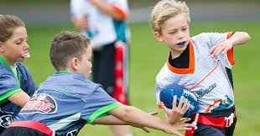
Reflecting on practice
In groups of 2 or 3 discuss the pedagogical processes that you see in PE lessons….
OR
In plain language, what does the teacher do to ensure that all children learn?
Notes:
5’
Take feedback

Slide 9
5. Key texts
Bailey, R. et al (2009) The Educational Benefits Claimed for Physical Education and School Sport: An Academic Review, Research Papers in Education, 24.1
Kirk, D. (2010). Physical Education Futures, Oxon: Routledge

Slide 10
Purpose of PE
In groups of up to 4, discuss why PE is on the curriculum?
What is the UNIQUE contribution of the subject?
Now prioritise your top 3 answers
Notes:
5’
Group discussion.
During the feedback focus on the UNIQUE contribution of PE so, for example, many people will say teamwork and social skills. Ask, ‘if PE disappeared tomorrow, would the children learn to work effectively with others?’ The answer is probably YES. So what would they NOT learn if PE was taken away?
Answer – educating the PHYSICAL and educating THROUGH the physical

Slide 11

The Big Picture
Will their physical education
impact on their future activity
levels and health?
Notes:
5’
Show video and make the point that if we are not careful we focus on minutia and we miss the big picture e.g. we worry about whether a child can perform a certain skill e.g. a spike in volleyball and we might ignore the fact the s/he cannot jump or, more importantly they are embarassed in a sports environment or they are hardly ever active.

Slide 12
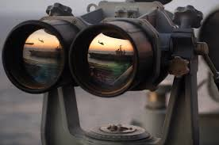
What’s your vision
In no more than 140 character, write a statement that sums up your vision for physical education
Notes:
5’

Slide 13
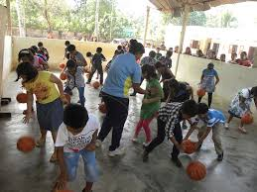
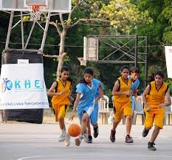
Sport v PE
A
B
?
E
D
C
Notes:
7’
In this slide, delgates are asked to discuss how they perceive the relationship between sport and PE.
Red circles = sport and green = PE.
A = two completely different constructs
B = overlapping constructs
C = PE is part of sport
D = Sport is part of PE
E = PE leads into sport
Any others?
Ask people to explain their thinking

Slide 14
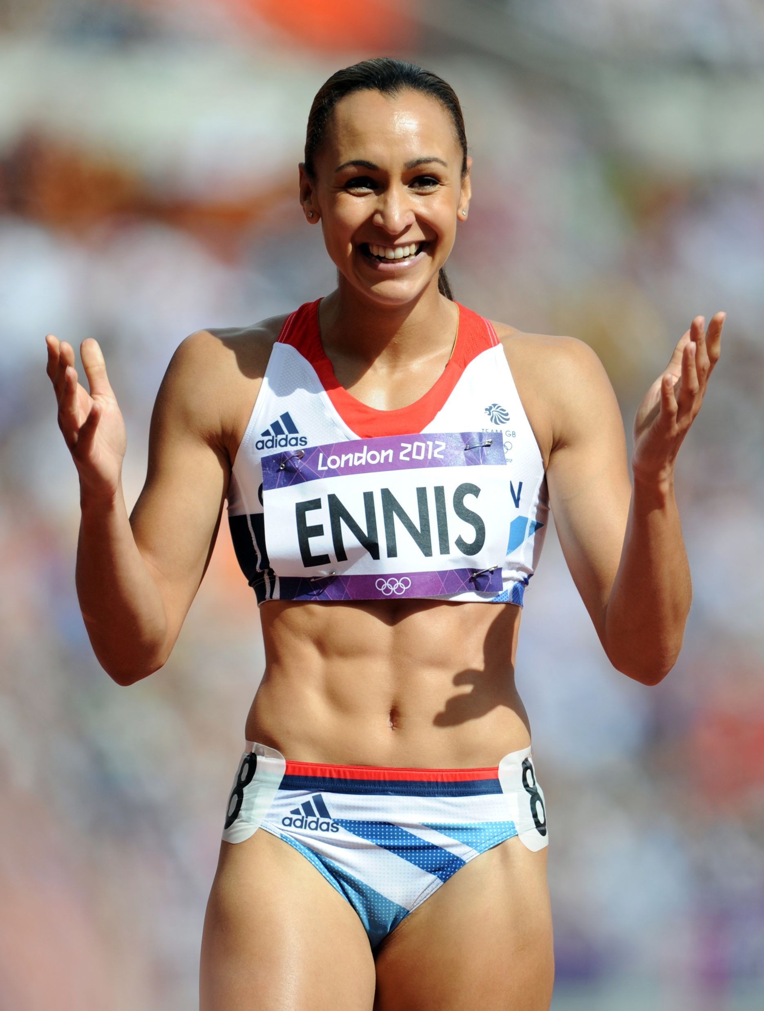

PE – servant to 2 masters?
Notes:
3’
Are we educating for good health of all pupils or elite performance?
Is it either / or?
If it’s good health, why does SPORT play such a prominent role in PE?
If it’s good health, how is this reflected in how pupils are assessed in PE? Are the children who are ‘good at PE’ not the most athletically able? Do you assess, health promoting behaviours and attitudes – refer back to moodule 1 – what is Health?

Slide 15
Clarity of purpose?
”The matter of what the core aims of the subject are remains far less clear and a source of apparent tension. Claims about the contribution of the subject to the children's development, later lives and to society are multiple and diverse.....we question the degree to which physical education can legitimately continue to make varied claims and pursue multiple agendas"-Penney and Chandler cited in Kirk (2009 p12)
Notes:
2’
Again, reinforce that purpose shapes practice which shapes children’s experiences.

Slide 16
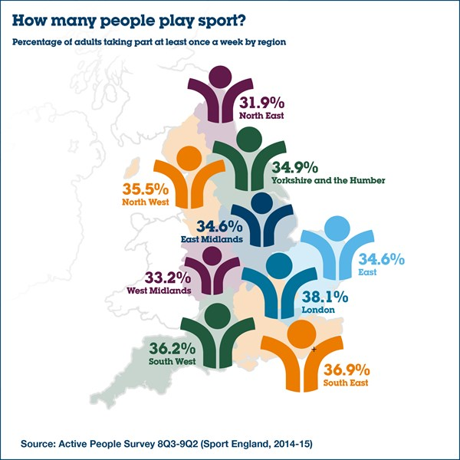
Uncomfortable truth
Spectacular failure
Notes:
10’
Less than half the UK population – around a 3rd of adults over 16 years old are physically active enough to maintain good health.
Ask delegates if they know how active adults should be? The Chief Medical Officer in the UK states 150 minutes per week. For children it’s 60 minutes per day.
You may need to find similar statistics for Greece, Spain and other European countries.
How does this low activity rate reflect on PE?

Slide 17
Is our practice aligned to our aims
Consider who benefits from the following aspects that tend to dominate the PE experience:
Focus on skill and technique
De-contextualised practices
Linear learning (start small and end big)
See Kirk (2009)
Notes:
5’
Where does skill and technique come from – adult SPORT. So the model is very much ‘do it like this (and if you don’t do it like this, you are doing it wrong)’.
De contextualised – practices that happen in a situation that does not reflect the authenticity of the activity e.g. throwing and catching in pairs. It is not that commentators say that this is WRONG, it is the reason why we often use it that is questionable.
Show video to exemplify this type of pedagogy.

Slide 18
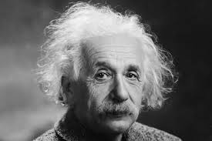
Who does the status quo serve?
“We can’t solve problems
by using the same kind
of thinking we used
when we created them”
Einstein
PE and Sports Pedagogy = an issue of social justice and equity
Notes:
Los alumnos en pareja adivinan las palabras que faltan. 1 minuto por slide.

Slide 19
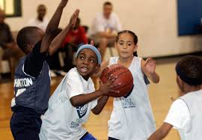
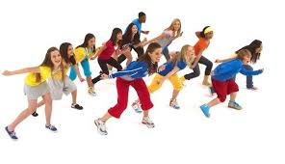

So if children are to remain active, what abilities do they need?
The ability to move in a range of physical environments
Notes:
1’

Slide 20

So if children are to remain active, what abilities do they need?
2.
Notes:
1’
The ability to think as they move plus certain attitudes …. See next slide

Slide 21
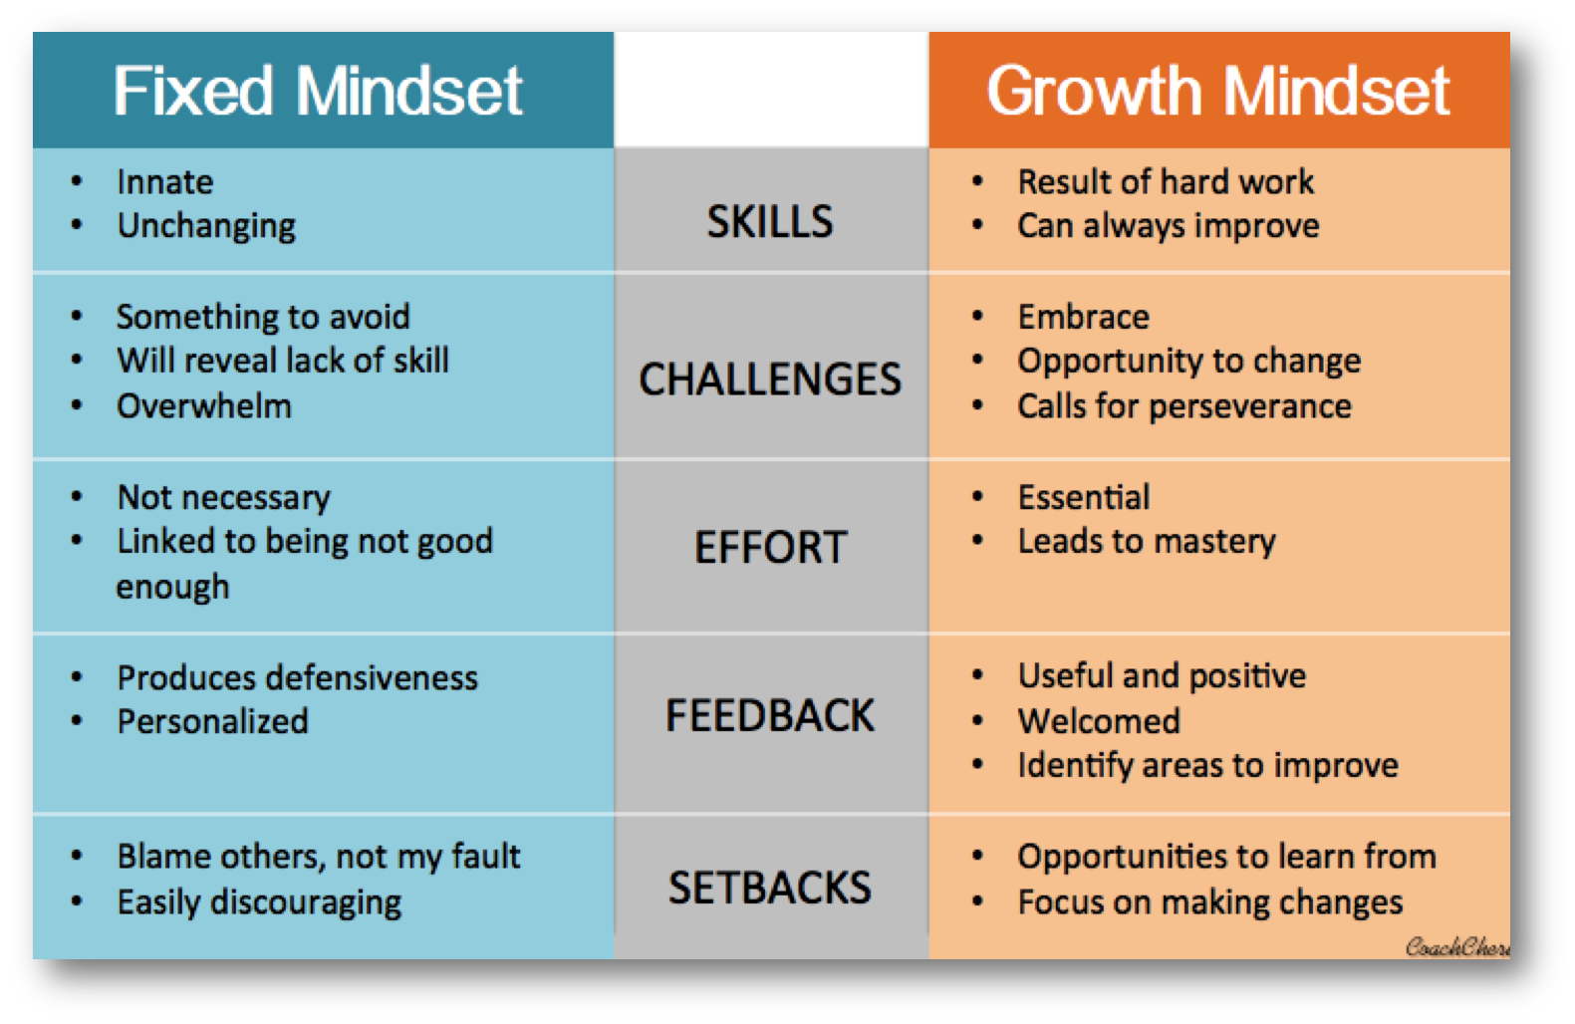
So if children are to remain active, what abilities do they need?
3.
Notes:
5’
Certain attitudes that support learning.
Spend a few minutes comparing Fixed v Growth mindset. Reference the work of Carol Dweck.

Slide 22
Session 2.1. Objectives
Clarify the relationship between physical education and sport, health (including weight management) and physical activity
Develop understanding as to why physical education is a compulsory part of the school curriculum and the unique contribution it may make to the education of children
To support students in critically examining current policy and practice in light of the above
Notes:
3’
Did we get there?

Slide 23
Pupil Health & Well-Being
MODULE 2
SESSION – 2
Exploring Teaching Strategies in Physical Education

Slide 24
1. Session 2.2. Objectives
Critically examine the relationship between pedagogy and inclusion
To reflect upon the learner experience
Explore the potential barriers to adopting new pedagogical approaches
Notes:
3’

Slide 25
2. Let’s play and learn
Notes:
60’
In the first part of the session, the facilitator should take the delegates through two x 35 minute PE lessons pitched at children aged 9-13.
The two lessons should be very different and illustrate two very different pedagogical approaches. The lessons below draw on and contrast a traditional skills focused approach with a ’game sense’ approach.
Delegates need to be told that they are taking part in the lesson as children but they are also reflecting as professionals.
Suggested format
Activity: Invasion Games
Lesson 1
Objective: To improve the ability to pass a ball
Warm up – standard warm up: laps, stretching etc.
Skill practice: In pairs passing a ball. Teacher demonstrates and explains teaching points to chest pass and bounce pass.
Add competition – how many passes can you complete in 30 seconds. Take answers publicly. Praise those with highest score.
>> Repeat with bounce pass
Apply: Group class in 4s. Play 3 v 1 where the 3 have to keep the ball away from the 1 ’defender’.
Game: Progress into 1 big game of End Ball. No running with the ball. The ball must be passed to someone from your team who is over the end line in order to score a point.
Plenary; Recall question – what were the key points of technique that you need to remember when doing a chest pass.
Lesson 2
LO To improve our ability to maintain possession in games play.
Lesson starter: Move around and as you pass someone give them high 5
>> Alternate high 5 and then low 5
>> Improve quality of movement by making High 5 very high (jump) and low 5 just above the ground.
>>After each high or low 5, move around a marker on the periphery of the play area and then back in to play.
Game 1
4 v 4 with a number of games going on at the same time.
Objective of the game is to keep the ball for as long as possible. No running with the ball.
Key Q to be asked after the activity – what do you need to do as a team to keep possession?
Important for later - one person on each team should try to count consecutive passes.
Ask Key Q
Expected answers: move into space, move ball quickly, communicate verbally or non verbally if you want the ball to help ball holder, pass accurately, stay calm.
Practice: ’Let’s see if we can all get better keeping the ball’.
Simple practice – in your team give yourselves a number 1-4. You are not allowed to stand still if you do NOT have the ball. The ball needs to be passed through the team in number order (1-2-3-4-1-2-3-4 etc).
>>Reverse order
>>Pass and move around a marker on the outside of the court
>>Put 2 or 3 team in one space to make it much more crowded. Encourage people to receive the ball in congested spaces.
Praise good learning – ‘you’re practicing hard’, ‘you’re really thinking about what you’re doing’ etc.
Return to game. Set target based on number of passes in first game.
Did you meet your target number of passes?
Plenary: What do you need to work on next week.

Slide 26

3. Reflections
Think about the two lessons.
In small groups consider the differences
between the two lessons. Compare:
Learning objective – what difference did this make on the lesson activities?
Lesson structure
How the lessons started
How they finished
Other comments? How did the lessons feel?
Notes:
15’
Learning objective – what difference did this make on the lesson activities?
1st lesson primarily skill focused. 2nd lesson more expansive.
1st lesson teacher centred. 2nd lesson much more child centred.
2nd lessons more opportunities for peer learning
Lesson structure
1st – linear. 2nd-non linear. Game-practice-game
What difference does this make?
How the lessons started
Warm up v lesson starter. 1 is to do with adult performance sport and the other is to do with learning.
How they finished
Recall question v reflection on progress and next steps.

Slide 27
4. Analysis
Two contrasting lesson structures
Traditional, skill focussed pedagogy | Game sense pedagogy
Warm up Skill practice Minor game Major game Plenary | Lesson starter Purposeful game Let’s bet better – practice Return to game (with or without progression) Plenary
Notes:
5

Slide 28
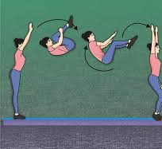
5a Teacher talk
Activity
Think of any skill or movement.
Find a partner and ’teach’ it to your partner
When you have done it, change over so you both have a chance to be the teacher and the learner
Notes:
5
Observe and listen to group
It is likely that the only mode of communication will be INSTRUCTION

Slide 29
5b Teacher talk
Question
What do you do or say to ‘teach’ the skill?
Did anyone hear their teacher
Do anything but offer INSTRUCTION?
What else could the teacher say?
Notes:
5 + 5 for conversation
Repeat activity using only questions.
Ask group what difference this makes….ownership, learner feels more important, learner is actively involved in their own learning etc. This should lead to deeper learning and permanence.

Slide 30
6 Barriers
In small groups, discuss any barriers that may need to be overcome if your school was to adopt game sense pedagogy. If your school already uses this, share the processes you went through to manage the change
Notes:
10’ including feedback.

Slide 31
7 Prepare for next session
Complete your learning journal with reflections on this session.
Prepare your micro teaching session. Prepare a lesson that you will deliver (all or part of) to the group next session
Notes:
30
Preparation for some delegates may be very difficult so they may require more guidance. In which case 20-30 minutes can be devoted to the task.
Some suggested learning objectives that may help:
>To improve our ability to move my opponent(s) in net games (Volleyball, tennis)
>To improve our ability to restrict runs being scored in strike fielding games (baseball, softball etc)
>To explore ways and successfully reduce shooting opportunities for the other team in invasion games (basketball, football, handball etc)
>To improve our ability to win the ball back in invasion games.

Slide 32
Further reading
Penny, D. and Clarke, G. (2005) Sport Education in Physical Education, Routledge
Siedentop, D. (2011) Complete Guide to Sport Education, Human Kinetics
Furley, P. Frowin, F. et al, (2016) Just Play It – Innovative, International approaches to games: Die6. Internationale Teaching Games for Understanding Konferenz

Slide 33
1. Session 2.2. Objectives
Critically examine the relationship between pedagogy and inclusion
To reflect upon the learner experience
Explore the potential barriers to adopting new pedagogical approaches
Notes:
3’ Did we get there?

Slide 34
Pupil Health & Well-Being
MODULE 2
SESSION – 3
Putting it into Practice
Applying non linear pedagogy in PE – micro teaching

Slide 35
1. Session 2.3. Objectives
To have an opportunity to deliver and review a ’lesson’ using the alternative PE pedagogy
To engage constructively and analytically in peer review of the lessons to enhance reflectivity
Notes:
This is a practical session in which delegates have the opportunity to lead their peers (or children if possible) in a lesson of their choice and planning.
The facilitator will need to make sure everyone has sufficient time to deliver and take part in a review conversation

Slide 36
2. Points for discussion
Was the learning clear?
Did ALL the activities support the intended learning?
How did the lesson feel for the learners?
Did the learners know if they had made progress? How?
What did the teacher talk about most?
Other comments
Notes:
These questions can be used to review each session

Slide 37
Pupil Health & Well-Being
MODULE 2
SESSION – 4
Working with delivery partners

Slide 38
1. Session 2.4. Objectives
To consider the Physical Education and Sport workforce
To explore how we build supportive partnerships to enhance the quality of physical education
Notes:
This session explores how we utilise local resources, facilities and personnel to support our PE programmes
Ideally, this session will be delivered in a community facility that works with children and young people.

Slide 39

Group discussion
In small groups share how you utilise local facilities, personnel or resources to support PE

Slide 40
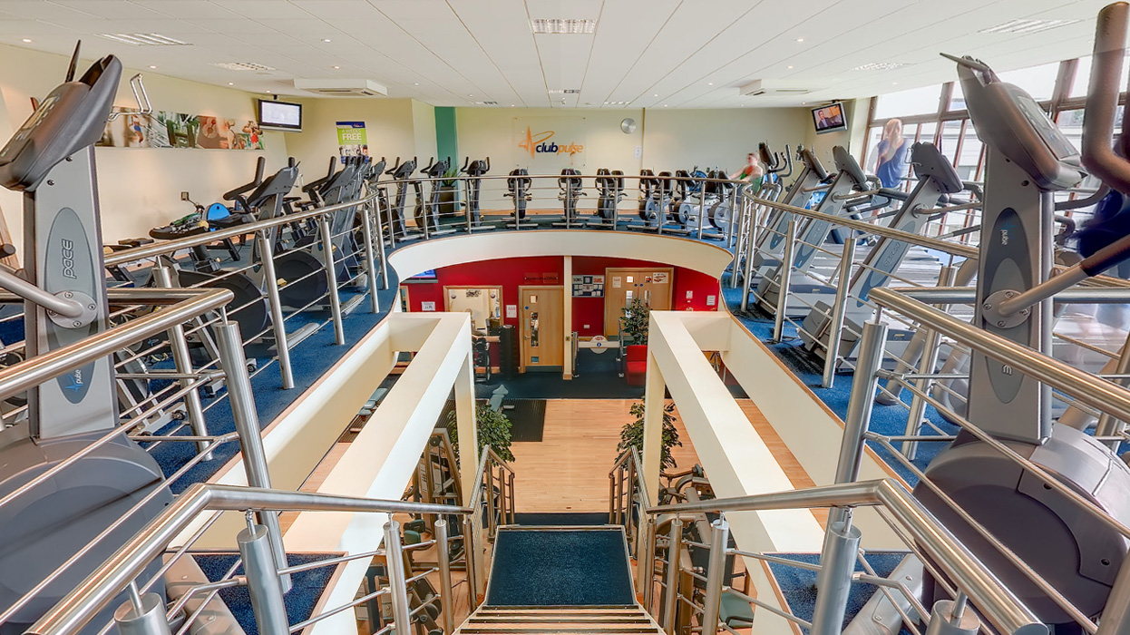
Group discussion
What are the benefits?
What are the challenges?
Discuss possible solutions to overcome the challenges

Slide 41

Group discussion
How do you communicate the learning outcomes?
How does the provider know where the learning fits into the PE curriculum?
Do you manage to find time to co-plan?

Slide 42

Review of the module
Please complete the feedback form
What was the most useful part of the module?
How will the module impact on practice?

