Slide 1

Pupil Health & Well-Being
Module 2:
Curriculum, Teaching and Learning Strategies for Physical Education

Slide 2


1. Objectives
Analyze how research and pedagogical theory translate into effective practice in schools;
What effect does different teaching styles and learning strategies have on children in PE?
Develop a contemporary and critical view of Physical Education in theory and practice.

Slide 3
Purpose of PE
In groups of up to 4, discuss ‘Why is PE taught in school?’
What are the UNIQUE contributions of the subject?
Think about…
If PE disappeared tomorrow, what would children miss out on?
Now prioritise your top 3 answers
Notes:
5’
Group discussion.
During the feedback focus on the UNIQUE contribution of PE so, for example, many people will say teamwork and social skills. Ask, ‘if PE disappeared tomorrow, would the children learn to work effectively with others?’ The answer is probably YES. So what would they NOT learn if PE was taken away?
Answer – educating the PHYSICAL and educating THROUGH the physical

Slide 4

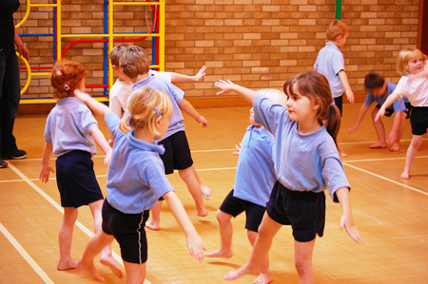
Activity

Slide 5
Extrinsic and intrinsic learning

Slide 6

Lesson 1:
Competitive
Exclusive
Elitist
Objectives met by all?
Focus purely on physical

Slide 7
Lesson 2:
Clear/multiple objectives met
Inclusive
Children setting their own challenge
Not only physical

Slide 8
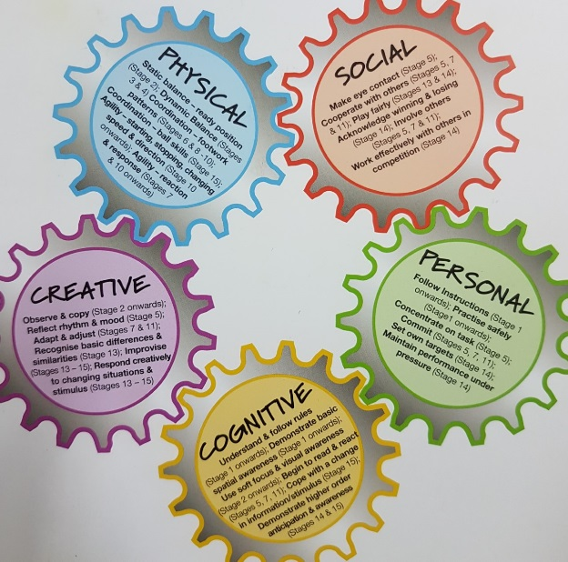
Physical – Coordination, balance, agility
Personal – Setting own targets
Creative - Adapting
Social – Eye contact, ‘good morning’, interacting
Cognitive – Spatial awareness

Slide 9
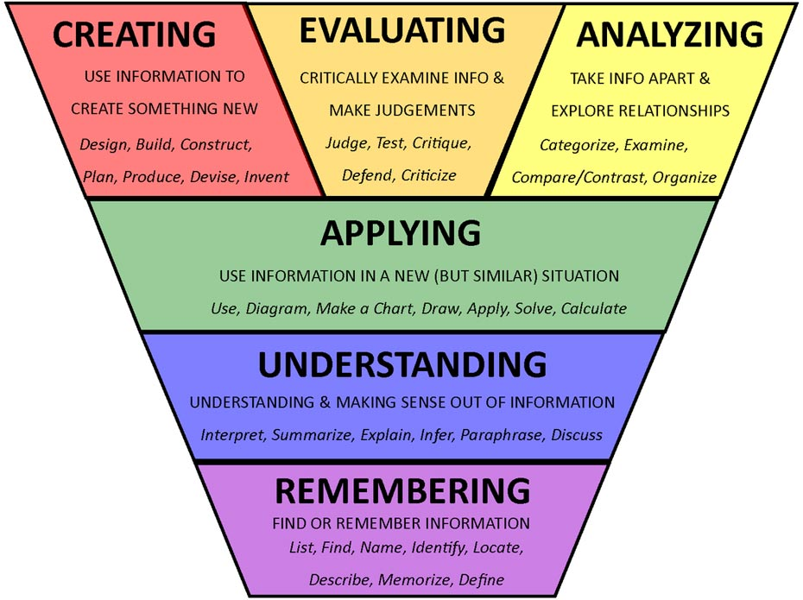

Slide 10
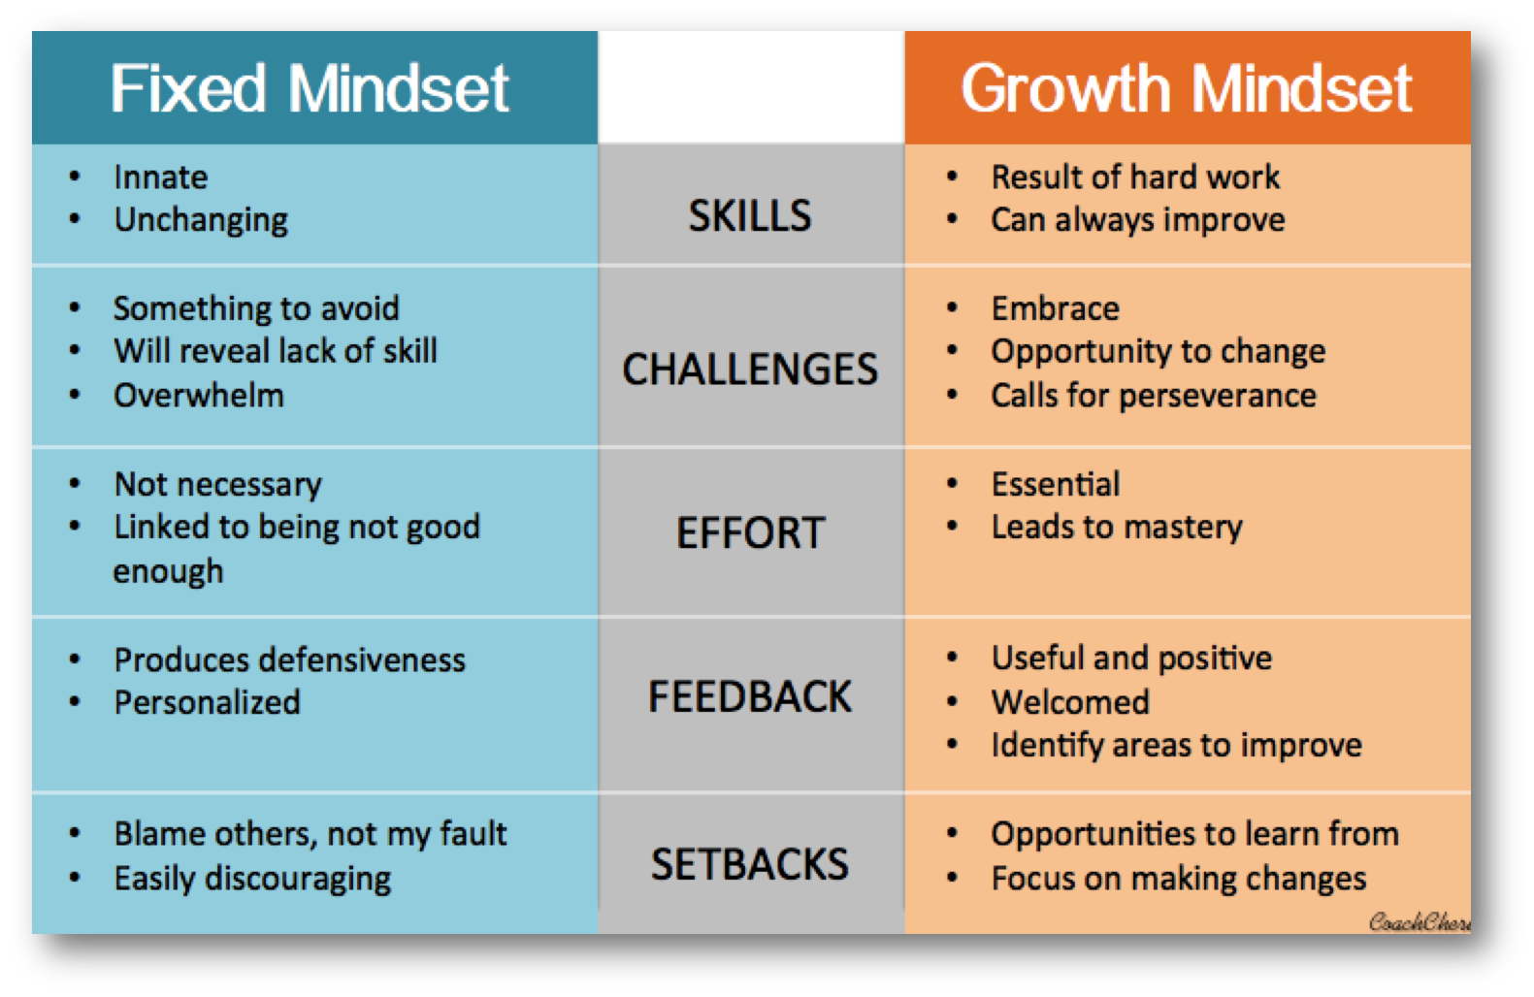
So if children are to remain active, what abilities do they need?
Notes:
5’
Certain attitudes that support learning.
Spend a few minutes comparing Fixed v Growth mindset. Reference the work of Carol Dweck.

Slide 11
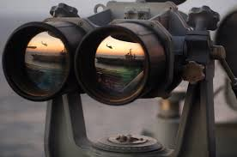
What’s your vision
In words or pictures show something that sums up your vision for physical education within your organization
What does it look/feel/sound/taste like?
Notes:
5’

Slide 12

Review of the module
Please complete the feedback form
What was the most useful part of the module?
How will the module impact on practice?

