Slide 1

Pupil Health & Well-Being
Module 2:
Curriculum, Teaching and Learning Strategies for Physical Education

Slide 2
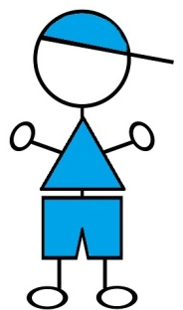

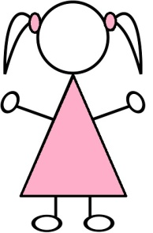




Public Health Context
Evaluation by The National Obesity Observatory shows:
One in five children in Reception is overweight or obese (boys 23.5%, girls 21.6%)
One in three children in Year 6 is overweight or obese (boys 35.4%, girls 32.4%)

Slide 3
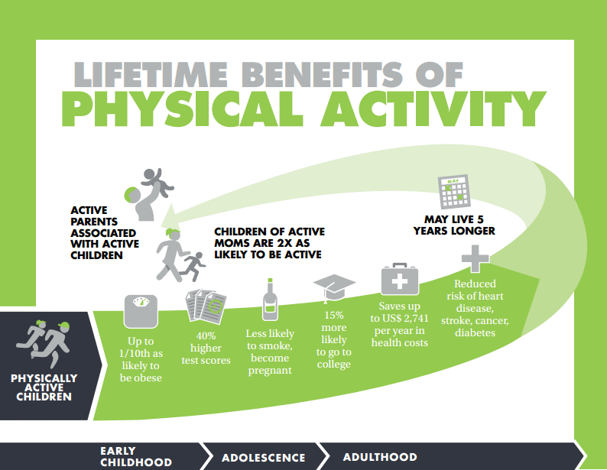
Public Health Context

Slide 4

5 More Years

Slide 5
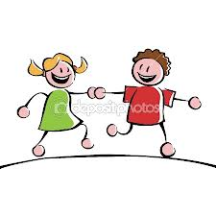

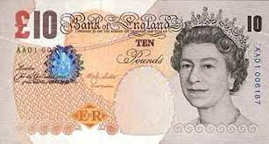



The costs of Physical Inactivity
Physically inactive children
£21bn cost to NHS
£1750 a year extra health costs
Lower
attainment
Children with inactive parents are far less likely to be active and twice as likely to be obese
2 extra days a year missed from school
Notes:
How do we break the cycle?

Slide 6
Wise words:
‘We can do nothing without the_______, let us take care that it is in the best condition to sustain us” Socrates
We have to make sure that our kids still feel good about themselves no matter what their______, who they are, what they look like, what they’re eating” Michelle Obama
“You can discover more about a person in an hour of _____ than in a year of conversation” Plato
“We are what we repeatedly do. Excellence, then is not an act but a ______” Aristotle

Slide 7
Wise words:
Good health supports successful learning. Successful learners support health. Education and health are inseparable.
World Health Organisation
The biggest difference to inequalities in child health will not be made by the NHS, but by interventions in other sectors.
What Works for Children
Reducing inequalities 2000

Slide 8
Public Health Context
Physical activity is high on the agenda and how it can assist young people in making lifestyle choices.
Healthy weight is about the understanding of healthy active lifestyles NOT about obesity.
There is strong evidence that regular physical activity is associated with numerous health benefits for children

Slide 9
Our Context
OfSTED will now be inspecting PE, School Sport and Healthy Active Lifestyles
£320m of investment for schools via the PE and School Sport Premium
Using the impact of physical activity and school sport to raise standards with vulnerable groups
Narrowing the achievement gap with pupil premium pupils

Slide 10
Impact on Education & Health Outcomes

Slide 11
Wellbeing and Attainment
DfE reported in “The Impact of Pupil Behaviour and Wellbeing on Educational Outcomes” 2012;
“children with higher levels of emotional, behavioural, social and school well being, on average have higher levels of academic achievement and are more engaged in school, both concurrently and in later years”
“children with better emotional wellbeing make more progress in primary school”
“pupils on free school meals who would benefit from increasing their physical health and sense of well being have attainment levels 22% lower than their peers”

Slide 12
Obesity and Inactivity
There is strong evidence that regular physical activity is associated with numerous health benefits for children. The UK Chief Medical Officers’ recommend that all children and young people should engage in moderate to vigorous intensity physical activity for at least 60 minutes every day. Many schools already offer an average of two hours of PE or other physical activities per week. However, we need to do more to encourage children to be active every day. Every primary school child should get at least 60 minutes of moderate to vigorous physical activity a day. At least 30 minutes should be delivered in school every day through active break times, PE, extra-curricular clubs, active lessons, or other sport and physical activity events, with the remaining 30 minutes supported by parents and carers outside of school time.

Slide 13
Our Context
What is Health and Wellbeing?
What does it mean to you?
What does it mean to school?
What does it mean to children?
What does it mean to parents?

Slide 14
Health and Wellbeing
Physical Health
Physical education
Sport
Utility Activity
Recreational Activity
Social Capital
Communication
Self efficacy
Teamwork and groups
Relationships
(Employability)
HEALTH AND WELLBEING
Health Literacy
Understanding energy in v energy out
Risk taking behaviours
Labelling
Importance of sleep
(Lifestyle choices)
Emotional Wellbeing
Self Esteem and confidence
Resilience
Coping strategies
Sense of worth/contribution

Slide 15
Department for Education Vision:
To support the delivery of the PE and school sport primary premium, all national partners* have agreed the following vision and objectives:
A measurable and sustained improvement in school PE and sport, underpinned by high-quality teaching that increases participation levels in physical activity, and leads to healthier pupils who are more engaged across the whole curriculum. This will be our legacy to the London 2012 Olympic and Paralympic Games.
*Cabinet Office, Department for Education, Department of Health, Department for Culture Media
and Sport, Ofsted, Sport England, Youth Sport Trust, Association for Physical Education, County
Sport Partnership Network

Slide 16
Rationale
Physical activity levels drop between the ages of 7 and 9 in vulnerable children.
Provision of PE and school sport for these children is often overlooked.
Positive physical activity environments lead to lifelong participation where sustained involvement takes place (i.e. More than 20 weeks)
Schools are in a unique position to inspire and engage children in a positive environment through school based activity clubs.
Children will sustain participation where they have a sense of belonging and contribution.

Slide 17


Barriers
In small groups discuss some of the changes you think would make a difference in your schools and discuss any barriers that may need to be overcome if your school was to adopt a whole school approach to wellbeing
Notes:
10’ including feedback.

Slide 18
Good health supports successful learning. Successful learners support health. Education and health are inseparable
World Health Organisation (WHO)

